Slide 1
PKC School Estates Review Breadalbane Academy and the Highland Perthshire Community What's best for ALL our children?

Slide 2
Overview
Introduction
Status quo – current provision
School review process
Impacts and concerns
Action to date
Q&A
Call to action

Slide 3
Introduction
Small team of volunteers
Do not support closure of PHS
Challenging a flawed council process
Concerned about viability of two even smaller rural schools
Supporting the best education for children across Highland Perthshire

Slide 4
Status Quo – current provision

Slide 5
Status quo
Breadalbane Academy is the all-through school in Highland Perthshire
 | Breadalbane Academy (BA) | Pitlochry High School (PHS)
Senior years provision | S1-S6 | S1-S4
Current roll call (18/19) | 414 | 112
Maximum capacity | 784 | Approx. 230

Slide 6
Feeder primary schools and transition
Breadalbane Academy
Glen Lyon
Grandtully
Logierait
Kenmore
Pitlochry High School
Royal School of Dunkeld
Kinloch Rannoch
PHS transition to BA after S4
2018/19 year
65 + pupils from Pitlochry catchment

Slide 7
Senior phase teaching staff at Breadalbane Academy
43 members of full time and part time staff,
1 HT, 2 DHT
Teaching ratio
Approx. 10.5 pupils to teacher

Slide 8
Senior phase course choice
 | 1 | 2 | 3 | 4 | 5
AH | Art & Design Biology Geography Graphic Communication | Business Management Mathematics | English Physics Drama | Chemistry French Music | Engineering Science History Physical Education
H | Biology Chemistry English German Graphic Communication Health & Food Technology History Music Technology | Biology Business Management English Fashion & Textile Technology Mathematics Media | Administration & IT Art & Design Drama English Modern Studies | Computing French Mathematics Music Physical Education Physics Spanish | Biology Engineering Science Gaelic Geography Physical Education Physics Photography
Nat 3-5 SfW NPA | Application of Mathematics (S5/6 only) Chemistry English (S5/6 only) French German Hairdressing (N5 S5/6 only) Health & Food Technology Music Music Technology Photography NPA Rural Skills N4 | Art & Design Automotive Engineering N4 Biology Fashion & Textile Technology Geography Mathematics (S5/6 only) Media Music | Administration & IT Art & Design Chemistry Graphic Communication Hospitality Physical Education Physics Spanish Sport, Recreation & Uniformed Services (S5/6 only) | Biology Childcare Drama Engineering Science History Physical Education Rural Skills SPA (S5/6 only) | Biology Business Computing Design & Manufacture Gaelic Hairdressing N4 Hospitality Modern Studies Physics

Slide 9
A rounded successful school
STEM success
1 of 3 schools selected in Scottish Educational Awards
Wide sporting achievement across teams and up to national level
Monarch of the Glen – collaborative project with National Gallery
Rural skills –finalist in the education category of the Scottish Rural Awards 2019
Innovative Partnership with local adventure tourism sector - Featured on BBC Adventure show
Academic results
Times Top 50

Slide 10
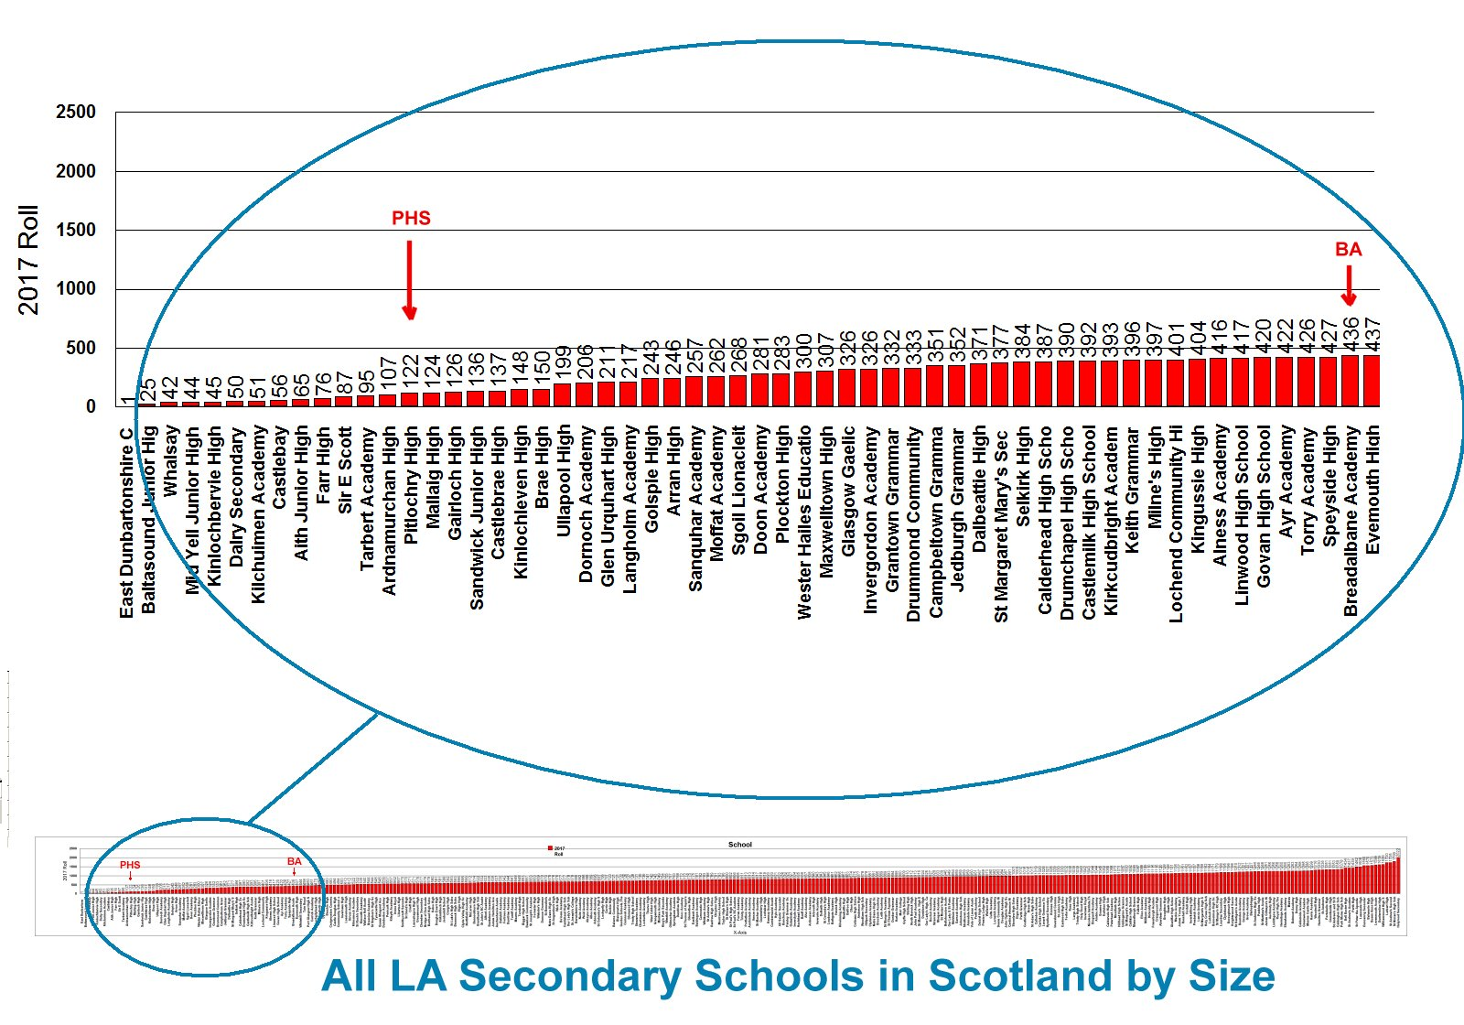
Size of schools

Slide 11
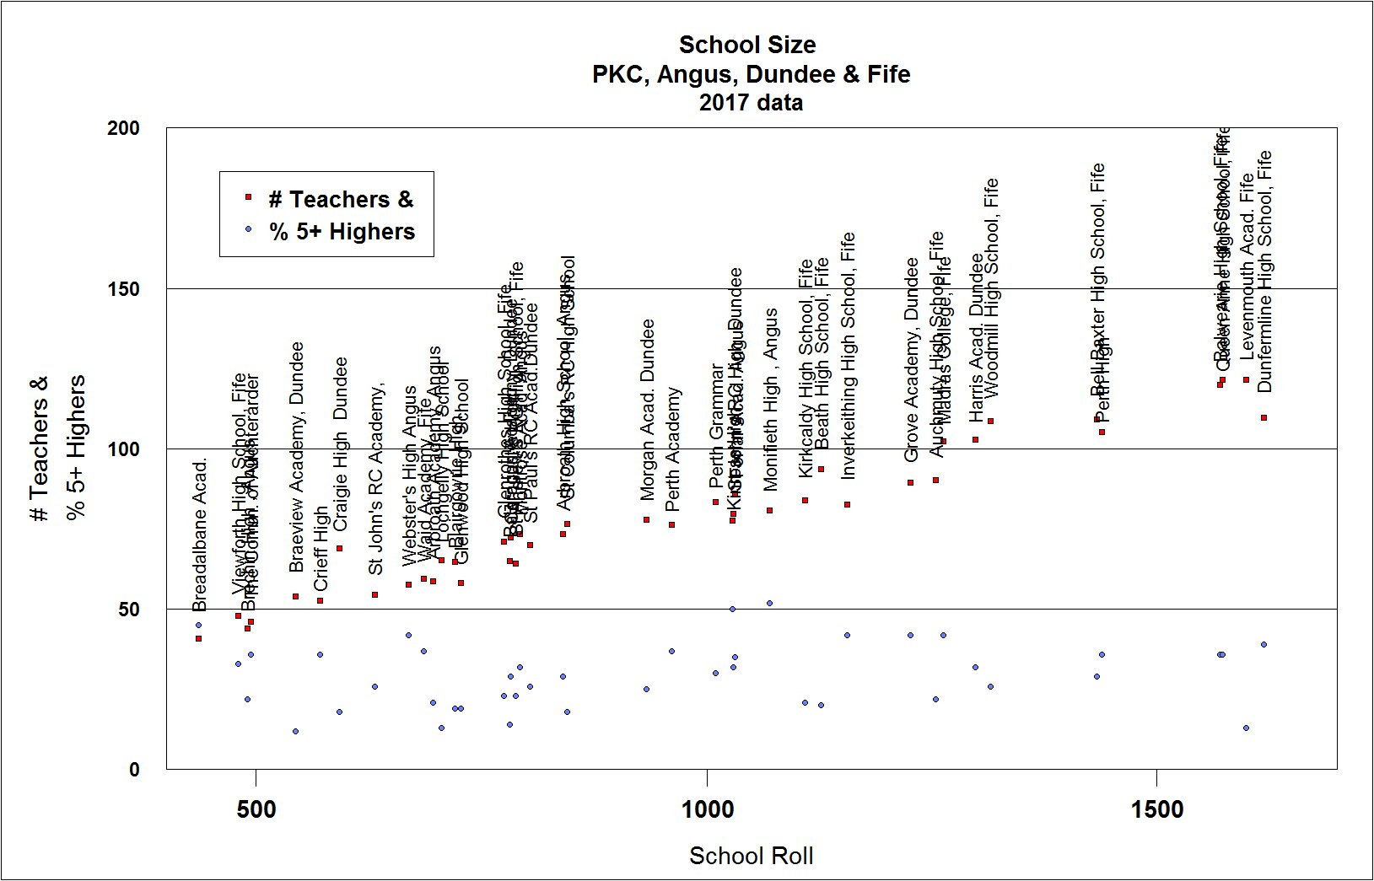
Size of schools

Slide 12
School review process

Slide 13
16/347 PRINCIPLES FOR REVIEW PROCESS 24.08.16
(i) schools occupancy rate greater than 60%;
(ii) school condition A or B; and
(iii) life expired buildings for replacement.
Start of 2010 Act
Schools Consultation (Scotland) Act 2010
Proposals Paper Issued by PKC
Consultation (at least 6 weeks of term-time)
Must Hold a Public Meeting
parents of the pupils at the affected schools
parents of children expected to attend an affected school within 2 years of the date of publication of this proposal document
pupils at the affected schools
Parent Council (if any) of the affected schools
teaching and ancillary staff at the affected schools
trade union representatives of the above staff
Community Councils
Relevant users of the affected schools
Statutory Process
16/485 HIGH LEVEL REVIEW 02.11.16
Schools selected for Detailed Options Appraisal
Pitlochry High in Phase 2
Pre-consultation stage under 2010 Act
This is a PKC Process
DETAILED Options Appraisal of Pitlochry High
5 OPTIONS PROPOSED
Consultation Opened Sat 3rd Nov 2018
6 no. Drop-in Sessions
Closed Friday 14th Dec
Collation of consultation completed by PKC before the start of February /comments and online questionnaires will be made available for view
Educational Aspects Reviewed by Education Scotland
PKC Publish FINAL CONSULTATION REPORT
Consultation Responses
Education Scotland Report
Details of Inaccuracies
Rural Schools
OPTIONS APPRAISAL REPORT
Summary of 5 Options
One Preferred Proposal
Detailed Analysis of One Proposal
Lifelong Learning Committee May 2019
SCOTTISH GOVERNMENT CAN CALL IN
(within 3 weeks of decision)
If decision is to close school parents can ask for it to be called in for review
School Closure Panel
PROPOSAL PAPER
Seeks approval of Preferred Proposal to move to statutory consultation
Decided at Lifelong Learning Committee

Slide 14
Right to be consulted
The Schools Consultation Act is clear that consultation is required on any proposal that would alter educational provision such as:
School closure
Change of catchment area
Change of admission arrangements
Consultation should include the wider community.

Slide 15
Right to be consulted
Statutory Guidance points to extensive community engagement as a key part of the pre-consultation/Options Appraisal process.
“an emphasis is placed on ensuring consultation, over and above that which might be required in terms of planning requirements and statutory consultation requirements”.
By not consulting with the wider Highland Perthshire community, we believe the process is not in accordance with
Parental Involvement Act (2006);
PKCs own guidelines; and
Statutory Guidance which states, that a Council should have
‘early engagement with the local community’ with a view to: ‘engaging and empowering communities to understand and help shape the proposals that affect them’.”
This has clearly not been the case

Slide 16
Pitlochry High School - options
Improve condition rating of school
Improve condition rating of school and include S5 and S6 at PHS to increase occupancy level
Improve condition rating of school and extend catchment area to increase occupancy level
S4 pupils move to BA and review use of PHS building
Close PHS (Secondary) and pupils move to BA

Slide 17
Impacts and concerns

Slide 18
Pitlochry High School – options impacting on BA
Improve condition rating of school
Improve condition rating of school and include S5 and S6 at PHS to increase occupancy level
Improve condition rating of school and extend catchment area to increase occupancy level
S4 pupils move to BA and review use of PHS building
Close PHS (Secondary) and pupils move to BA

Slide 19
Impacts of options 2 and 3 to BA
Lower pupil numbers (PHS pupils stay on to S6)
Reduce funding for teaching staff
Reduction in depth and range of subjects on offer in senior phase
Option 2 creates two small secondary schools in Highland Perthshire
National recruitment challenge
Narrower curriculum

Slide 20
Option 2 - delivery of education
Peripatetic teachers?
Shared headteacher of two nursery, two primary and two secondary schools?
Timetabling?
E-schooling untested as a core method?
Pupils bussed between campuses?
Increased delivery cost?

Slide 21
”I am surprised, given a number of factors, that PKC are considering altering provision. Breadalbane has a very new and expensively procured school building, has a pupil population who, in relative terms, don’t travel long distances to get to school, has a relatively broad curriculum, but does face challenges (recruitment and retention of teachers/a particular issue in small rural schools).
While recognizing that Pitlochry has S1 to S4 provision, and while some thinking might aspire to creating a very small S1 to S6 school, the associated risks, benefits and costs must be clearly advanced to enable a balanced judgement to be made; the most important benefit and risk to be weighed up is that to the young people across Highland Perthshire who will be directly impacted”
A Former Director of Education and Consultant on Education who has worked at the highest level

Slide 22
Concerns
Flawed process – PKC options appraisal process is not based on a recognised, standardised national process
Omission of vital community consultation across Highland Perthshire (Glen Lyon, Grandtully, Kenmore, Kinloch Rannoch, Aberfeldy, Royal School of Dunkeld)
Community is not empowered to ‘shape decisions’
Politically preferred option risks future of a good rural school
Same process for primary schools being applied to the only secondary school in the review

Slide 23
Actions to date
Emailed PKC estates team 8th Dec 18 registering concerns on lack of consultation
Met with PHS Parent Council seeking collaboration
Wrote to CEO in Jan 19 with objections to process / lack of consultation and request to stop
Lobbying MSPs, MPs, councilors
Independent experts (educational & legal)

Slide 24
Call to action
Support the PC and be part of the link between the parent body and school
Register your concerns with PKC directly
Raise community awareness
Join the PC mailing list
Prepare for consultation – but when?
Keep in touch
chairperson@
Facebook etc
Voice your thoughts, feedback and ideas for improvements of status quo

